Slide 1
Project Title
Banking Analytics Solution for Czechoslovakia Bank
Name: Aakash kumar
Date: 20-06-26

Slide 2
Project Overview
Banking Analytics Solution for Czechoslovakia Bank
Project Scope
1+ Million Records
8 Tables
5 Years of Banking Data
End-to-End Analytics Solution
Business problems:
The bank has accumulated five years of customer, account, transaction, loan, card and regional demographic data. However, management lacks a centralized analytical framework to monitor business performance, customer behavior, profitability, loan exposure and regional opportunities.

Slide 3







Business Context
Customer Visibility
Limited visibility into customer demographics and behavior.
Profitability Measurement
Difficulty measuring profitability.
Transaction Insights
Lack of transaction pattern analysis
Loan Portfolio Risk
Limited loan risk monitoring
Cross-Sell/Upsell
Difficulty identifying product opportunities
Regional Opportunities
Limited district-level insights
Customer Retention
Need for churn reduction strategies.

Slide 4
Business Objectives
Objective | Purpose
Customer Analytics | Demographics & Segmentation
Financial Performance | Revenue & Profitability
Product Performance | Product Adoption
Loan Portfolio | Risk & Growth
Operational Efficiency | Cost Optimization
Regional Analysis | District Performance
Customer Experience | Churn & Engagement
Strategic Growth | Expansion Opportunities

Slide 5
Technology Stack
Tool | Usage
SQL Server | Data validation, Quality checks
Python | Pandas, NumPy, Matplotlib, Seaborn, Plotly
Power BI | Modelling, DAX, dashboards
Power BI Service | Publishing, refresh, cloud deploy
PowerPoint | Executive storytelling & insights
Streamlit | Used in app deployment

Slide 6
Available Data Sources
Table | Type
Account | Dimension
Client | Dimension
Disposition | Dimension
Card | Dimension
District | Dimension
Transaction | Fact
Loan | Fact
Order | Fact

Slide 7
Data Dictionary
Table | Purpose | Primary/Foreign Keys
Account | Central banking account information | account_id (PK), district_id (FK)
Client | Customer demographic information | client_id (PK), district_id (FK)
Disposition | Links customers to accounts | disp_id (PK), client_id (FK), account_id (FK)
Card | Card product details | card_id (PK), disp_id (FK)
Transaction | Customer financial transactions | trans_id (PK), account_id (FK)
Loan | Loan portfolio information | loan_id (PK), account_id (FK)
Order | Standing orders & recurring payments | order_id (PK), account_id (FK)
District | Regional demographic & economic data | district_id/A1 (PK)

Slide 8
Key Observations
Account serves as the central entity, connecting customers, transactions, loans, and orders.
Transaction is the largest fact table, containing over 1 million records spanning multiple years.
Disposition acts as a bridge table, establishing the relationship between customers and accounts.
District table enriches customer and account data with demographic and economic indicators such as population, salary, unemployment, and crime rates.
Loan table enables credit risk and portfolio analysis through loan amount, duration, payment, and status information.
Card table supports product performance analysis by tracking card types and issuance details.
Order table captures recurring financial activities, helping analyze customer payment behavior and operational efficiency.
The data model follows a star/snowflake-like analytical structure, making it suitable for SQL analysis, Power BI dashboards, and predictive modeling.

Slide 9
ER Diagram
 |  |  |  |  |  |  | District
 |  |  |  |  |  |  | Account
Transaction |  |  |  | Loan |  |  |  | Order |  |  |  | Disp
 |  |  |  |  |  |  |  |  |  | Client |  |  |  | Card

Slide 10
SQL Data Checks & Consistency
Imported all 8 banking tables into SQL Server.
Consolidated 6 yearly transaction files into a single Transaction table.
Performed data quality and consistency checks.
Validated primary and foreign key relationships.
Checked for duplicate records, missing values, invalid dates and invalid business values.
Verified referential integrity across all tables.

Slide 11
Data Discrepencies (1/2)
Date Issues
Table | Issue
Account | Dates stored in YYMMDD format
Loan | Dates stored in YYMMDD format
Card | Dates stored as YYMMDD HH:MM:SS
Transaction | Non-standard date representation
Identify all non-standard date formats across Account, Loan, Card & Transaction tables.
Convert all YYMMDD / YYMMDD HH:MM:SS values to SQL YYYY-MM-DD format, prefixing 19 for 2-digit years.
Validate to Ensure zero NULLs, no row loss, and dates fall within 1993–1998 range.

Slide 12
Data Discrepencies(2/2)
Missing Values
Table | Issue
Account | Dates stored in YYMMDD format
Loan | Dates stored in YYMMDD format
Card | Dates stored as YYMMDD HH:MM:SS
Transaction | Non-standard date representation
Observation
Missing business attributes found.
Requires business validation.

Slide 13
Recommendations for Data Cleaning
Standardize all date fields to SQL DATE format.
Increase text column sizes for bank, operation, and purpose fields.
Validate missing values before imputation.
Remove duplicate records where applicable.
Validate orphan records through referential integrity checks.
Preserve raw source tables.
Use cleaned views for reporting and analysis.

Slide 14
Exploratory Data Analysis (EDA)
Objective
The purpose of Exploratory Data Analysis was to understand customer demographics, account behavior, transaction patterns, loan portfolio performance, and regional banking trends before performing diagnostic and predictive analysis.
Customer Demographics
Account Analysis
Transaction Analysis
Loan Analysis
Card Analysis
District Analysis
Key Outcome
EDA transformed raw banking data into meaningful business insights by identifying customer behavior, financial trends, and operational patterns that support strategic decision-making.

Slide 15
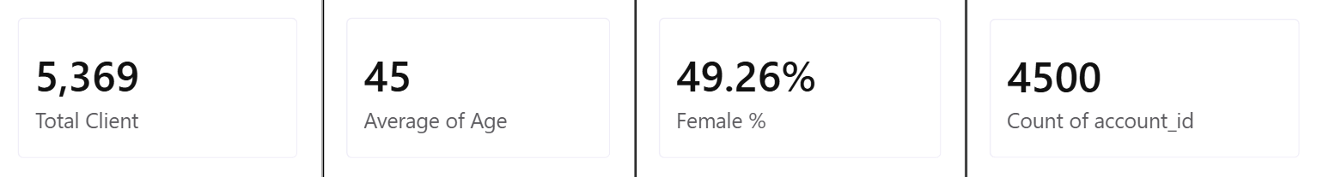
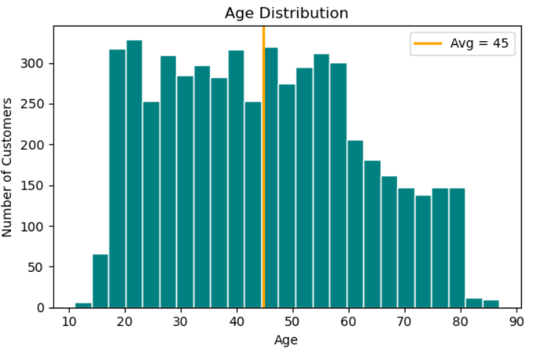
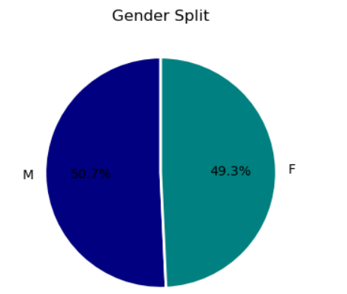
Customer Demographic Analysis (1/2)

Slide 16
Customer Demographic Analysis (2/2)
Business Insights
The customer base is evenly distributed between male and female customers.
The average customer age of 45 years indicates a mature and financially active customer segment.
Most customers belong to the 26–55 age group, representing the bank's primary revenue-generating population.
Younger customers (below 18 years) represent a small share, suggesting an opportunity for youth-focused banking products.
Recommendation
Develop targeted savings, investment, and digital banking products for customers aged 26–55, while introducing student and youth banking programs to improve long-term customer acquisition.

Slide 17
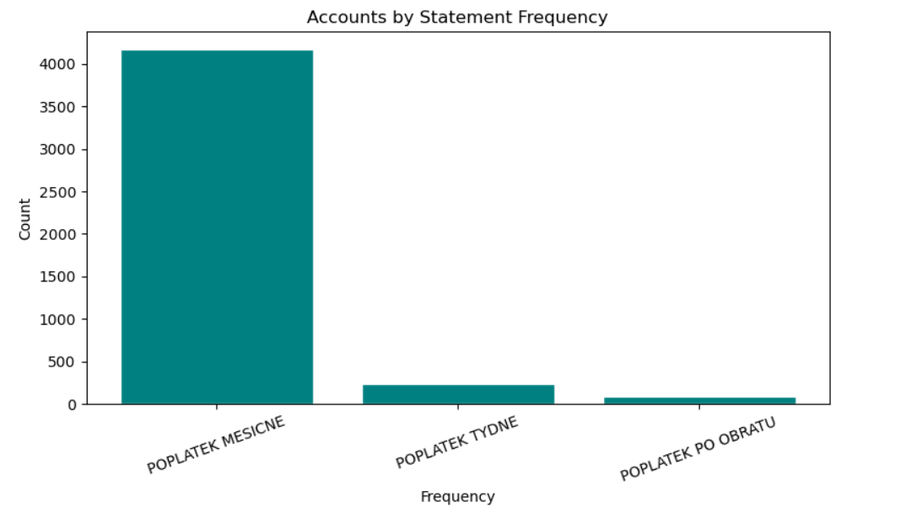
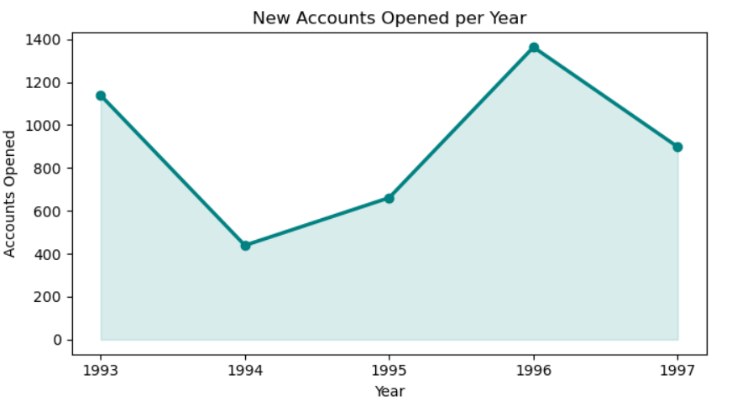
Account Analysis (1/2)
Total Accounts
4500
Saving Account
1533
NRI Account
1522
Salary Account
1445

Slide 18
Account Analysis (2/2)
Insights
Customer distribution across account types is relatively balanced.
NRI and Savings accounts slightly exceed Salary accounts, indicating diversified banking needs.
District-wise analysis reveals customer concentration in Hl.m. Praha, making it the bank's strongest market.
Recommendation
Strengthen marketing in high-performing districts while designing region-specific campaigns for districts with lower customer penetration.

Slide 19
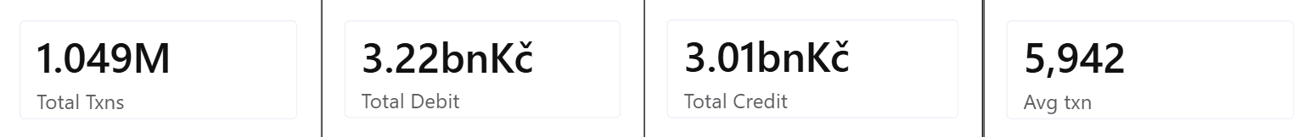
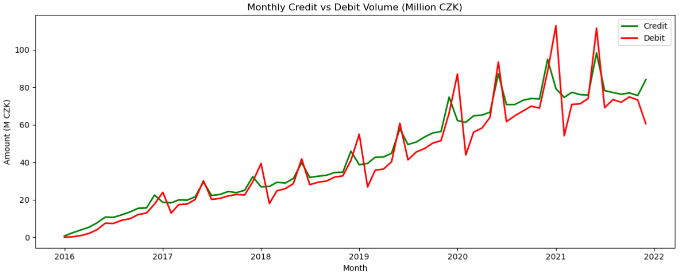
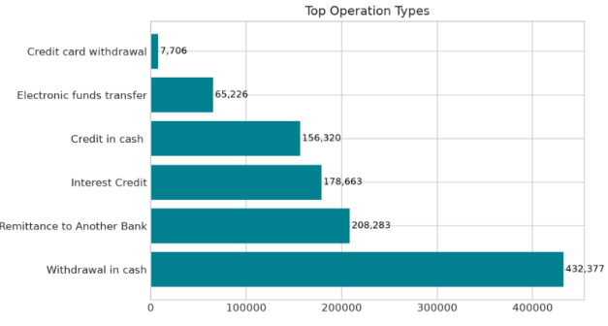
Transaction Analysis (1/2)

Slide 20
Transaction Analysis (2/2)
Insights
Debit transactions slightly exceed credits, reflecting active customer spending.
Interest credits and cash deposits are the most frequent transaction operations.
Monthly transaction trends remain stable, indicating consistent banking activity.
Recommendation
Introduce personalized spending insights and digital financial planning tools to encourage higher customer engagement.

Slide 21
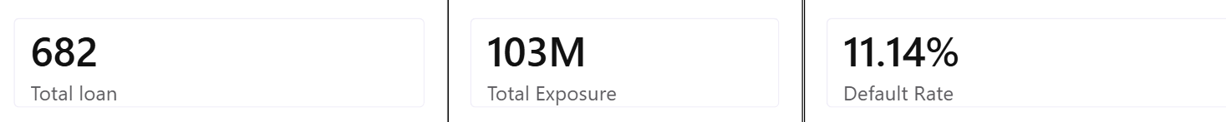
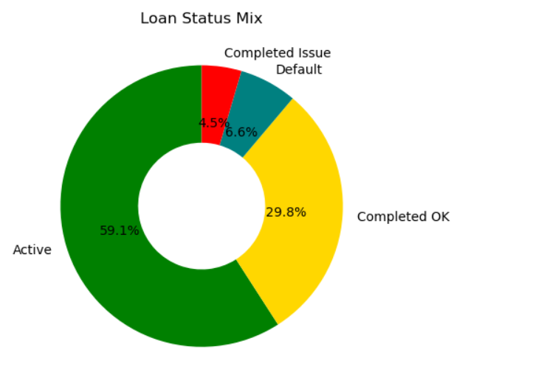
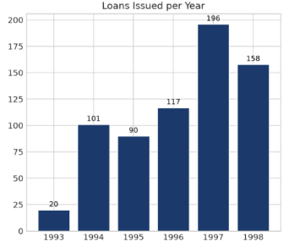
Loan Analysis (1/2)
Insights
Most loans are successfully repaid.
Default loans form only a small portion.
Longer-duration loans generally involve higher loan amounts.
Loan portfolio appears healthy.

Slide 22
Loan Analysis (2/2)
Insights
Nearly 59% of loans are active, indicating healthy lending activity.
The default rate remains low, suggesting effective credit assessment.
Loan disbursement increased over the years, reflecting business growth.
Longer-duration loans generally involve larger loan amounts.
Recommendation
Continue monitoring high-value, long-duration loans using predictive models to minimize future credit risk.

Slide 23
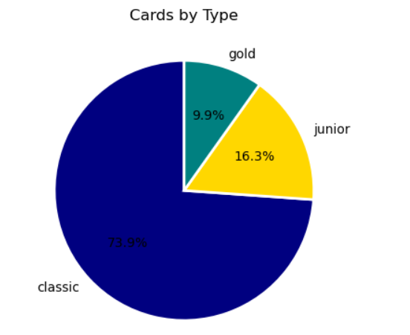
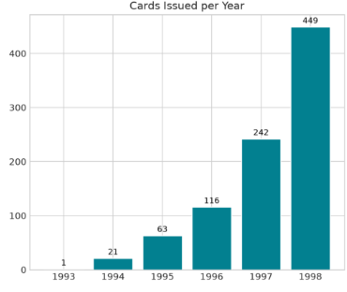
Card Analysis (1/2)
Total Car Issued
892
Classic 659
Junior
145
Gold
88

Slide 24
Card Analysis (2/2)
Insights
The Classic card dominates the portfolio, indicating it is the most popular and accessible card.
1998 recorded the highest number of cards issued (around 430+)
Recommendation
Promote Gold card upgrades by targeting loyal classic cardholders. By Offering reward points, cashback, or annual fee waivers.
Investigate why card issuance surged in 1998 and replicate successful strategies in future campaigns

Slide 25
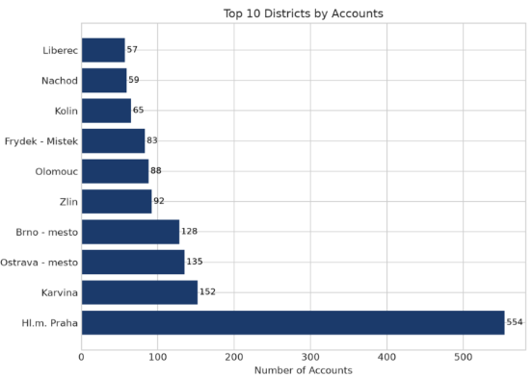
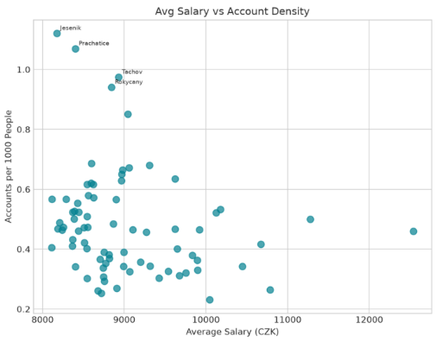
District/ Regional Analysis
Insights
High-income districts generally have higher banking penetration.
Urban districts contribute more customers.
Low-density districts provide opportunities for expansion.

Slide 26
Diagnostic Analysis
Objective
Diagnostic analysis was performed to understand the reasons behind customer behaviour, loan performance, transaction patterns and regional banking trends.
Business Question | Analysis Performed | KPI
Which accounts have high debit activity? | Debit vs Credit comparison | High Debit Ratio
Which customers are likely to default? | Loan status comparison | Default Rate
Which districts have better banking penetration? | Account vs District analysis | Penetration Rate
What drives card adoption? | Card ownership analysis | Card Adoption Rate
Are there dormant accounts? | Transaction activity | Dormant Account Ratio
Which transaction types are declining? | Transaction trend analysis | Trend Index

Slide 27
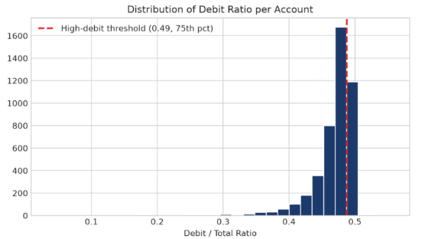
High Debit Account Ratio (1/2)

Slide 28
High Debit Account Ratio (2/2)
Objective
Identify customers spending significantly more than receiving.
Business Insight
Debit transactions slightly exceed credits.
Customers with consistently high debit activity require closer financial monitoring.
Such accounts may indicate cash-flow issues or heavy spending patterns.
Recommendation
Implement spending alerts and personalized financial planning services for high-debit customers.

Slide 29
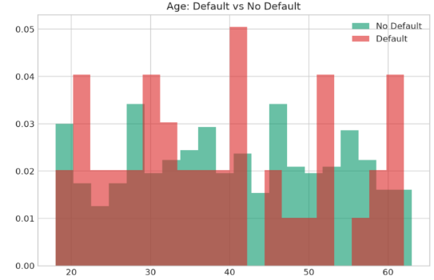
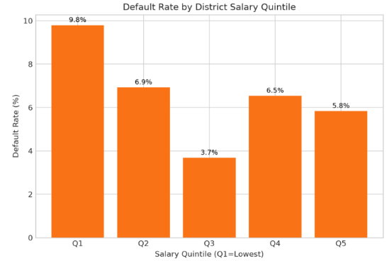
Loan Default (1/2)

Slide 30
Loan Default (2/2)
Objective
Identify factors contributing to loan defaults.
Dashboard Results
Total Loans: 682
Default Rate: 11.14%
Total Exposure: 103 Million
Business Insight
Majority of loans are Active or Successfully Completed.
Only a small percentage fall into Default.
Existing lending policy appears effective.
Recommendation
Use predictive models to identify high-risk customers before loan approval.

Slide 31
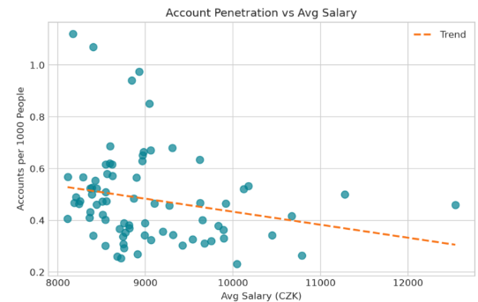
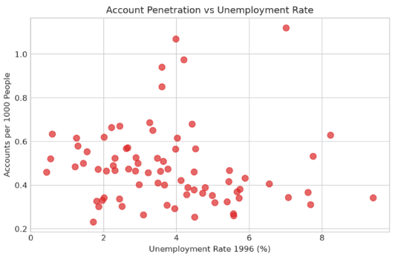
District Banking Penetration (1/2)

Slide 32
District Banking Penetration (2/2)
Objective
Compare customer concentration across districts.
Business Insight
Prague district has the largest customer base.
Banking penetration differs significantly between districts.
Lower penetration indicates untapped market potential.
Recommendation
Launch localized campaigns and expand banking services in low-performing districts.

Slide 33
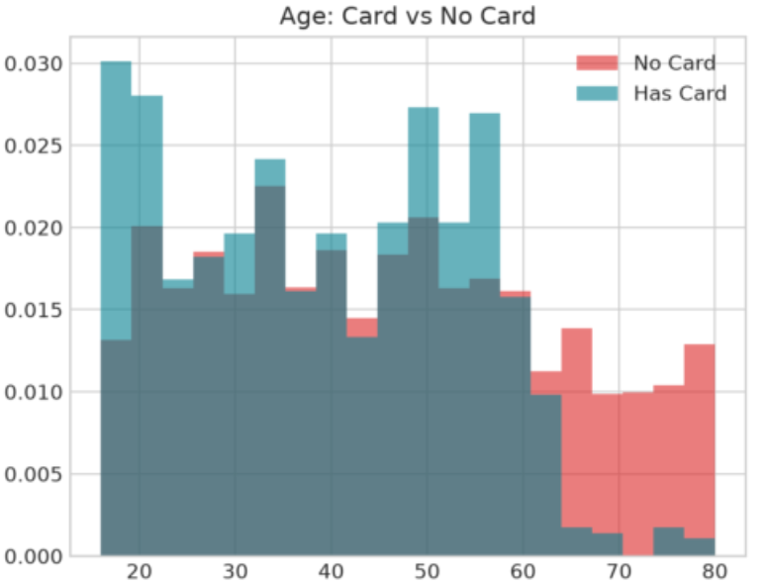
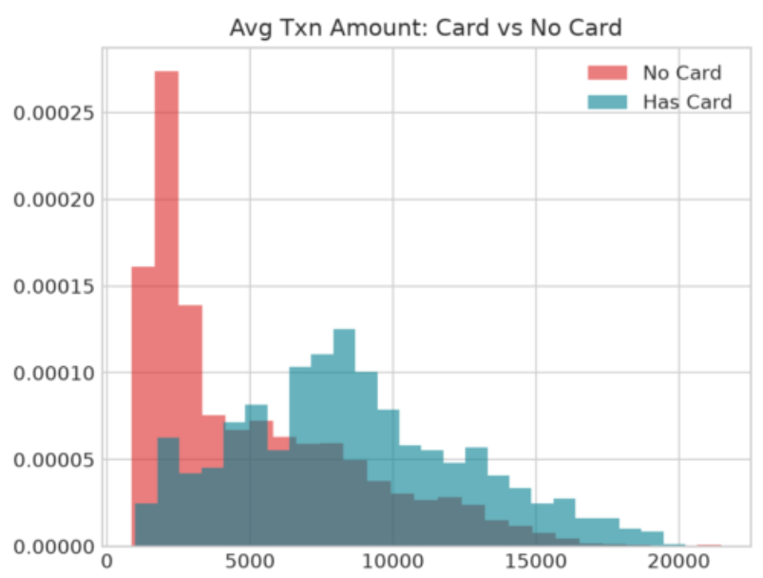
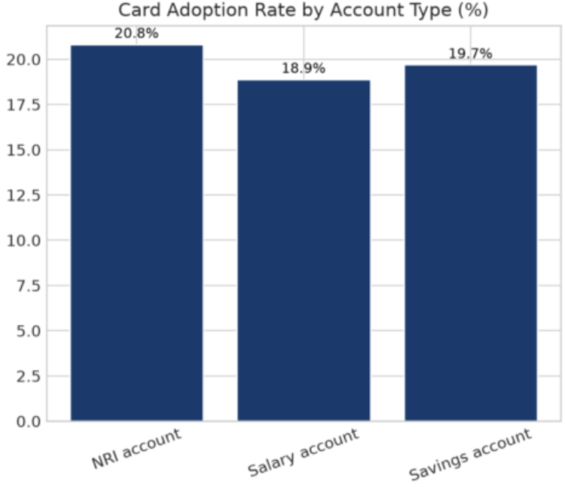
Card Adoption Analysis (1/2)

Slide 34
Card Adoption Analysis (2/2)
Objective
Understand card ownership among customers.
Business Insight
Card adoption varies across customer groups.
Active customers generally have higher product usage.
Cross-selling opportunities exist for customers without cards.
Recommendation
Offer promotional credit/debit card campaigns for eligible account holders.

Slide 35
Dormant Account Analysis
Objective
Identify inactive customers.
Business Insight
No dormant accounts were identified after data cleaning and analysis.
This indicates
Healthy customer engagement
Active banking relationships
Reliable transaction records
Recommendation
Continue monitoring inactive accounts periodically.

Slide 36
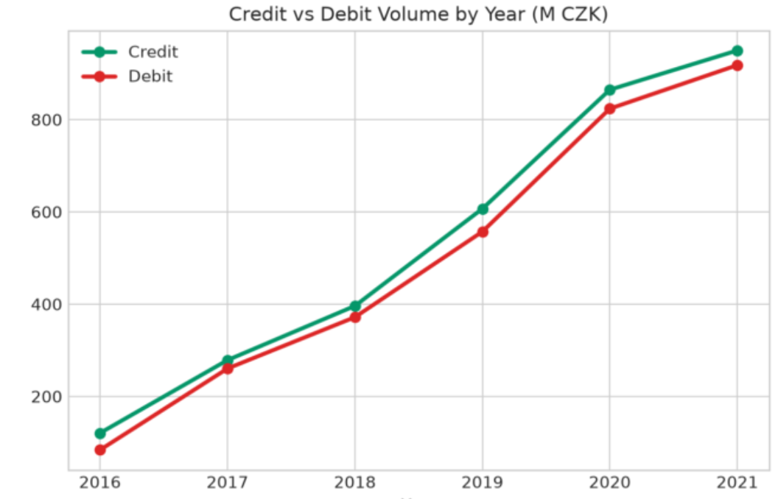
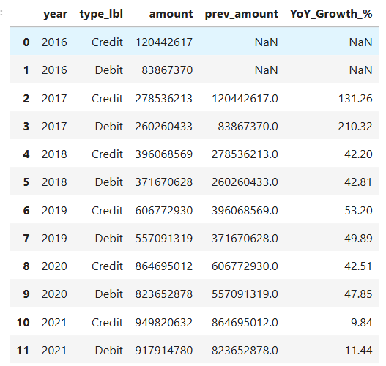
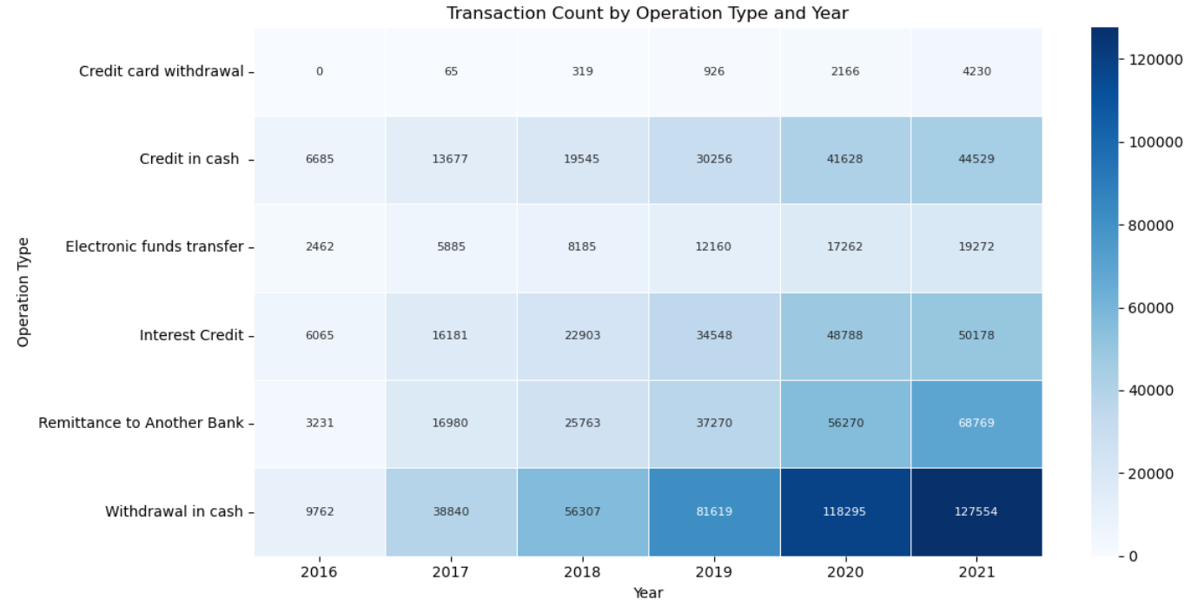
Transaction Trend Analysis (1/2)

Slide 37
Transaction Trend Analysis (2/2)
Business Insight
Transaction volume remains consistent throughout the year.
Interest credits represent the most frequent transaction operation.
Digital banking activity is increasing steadily.
Recommendation
Expand digital banking services and encourage electronic payments.

Slide 38
Predictive Analytics (1/3)
Objective
Predict Loan Default using Machine Learning.
Model Used
Logistic Regression
Workflow
Data Cleaning
Feature Engineering
Train-Test Split
Model Training
Model Evaluation

Slide 39
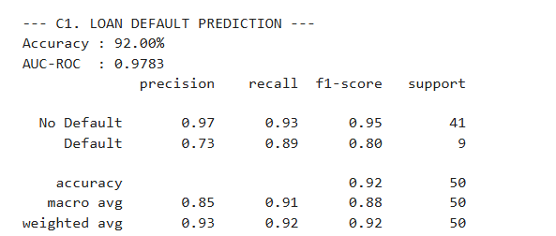
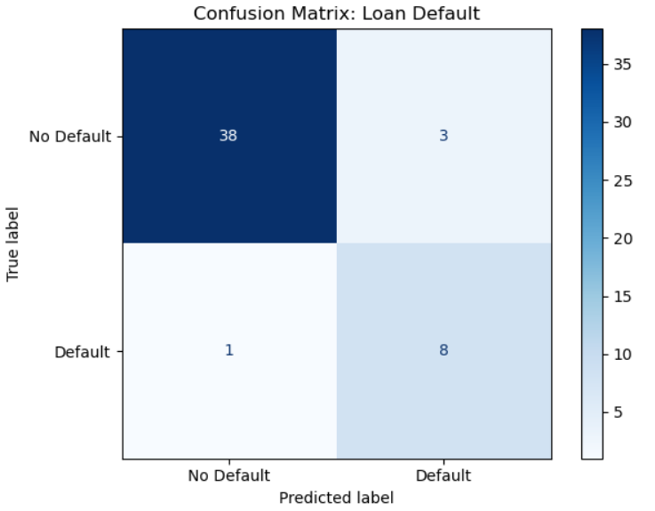
Predictive Analytics (2/3)

Slide 40
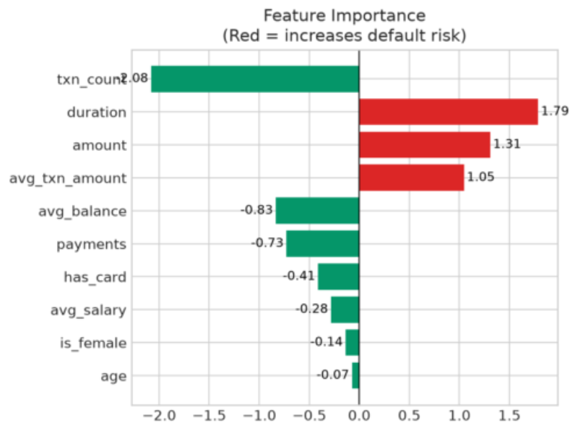
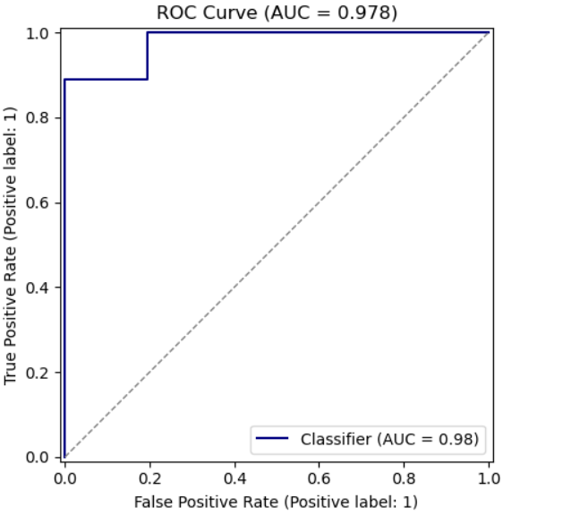
Predictive Analytics (3/3)

Slide 41
Why Logistic Regression?
Advantages | Business Value
Easy to interpret Fast training Suitable for binary classification Low computational cost Good baseline model | Helps the bank Reduce loan defaults Improve credit approval Minimize financial risk Increase profitability

Slide 42
Power BI Dashboard Overview
Dashboard Pages
Customer Analytics
Loan Analytics
Transaction Analytics
Purpose
Provide interactive monitoring of banking KPIs through dynamic filters and visualizations.

Slide 43
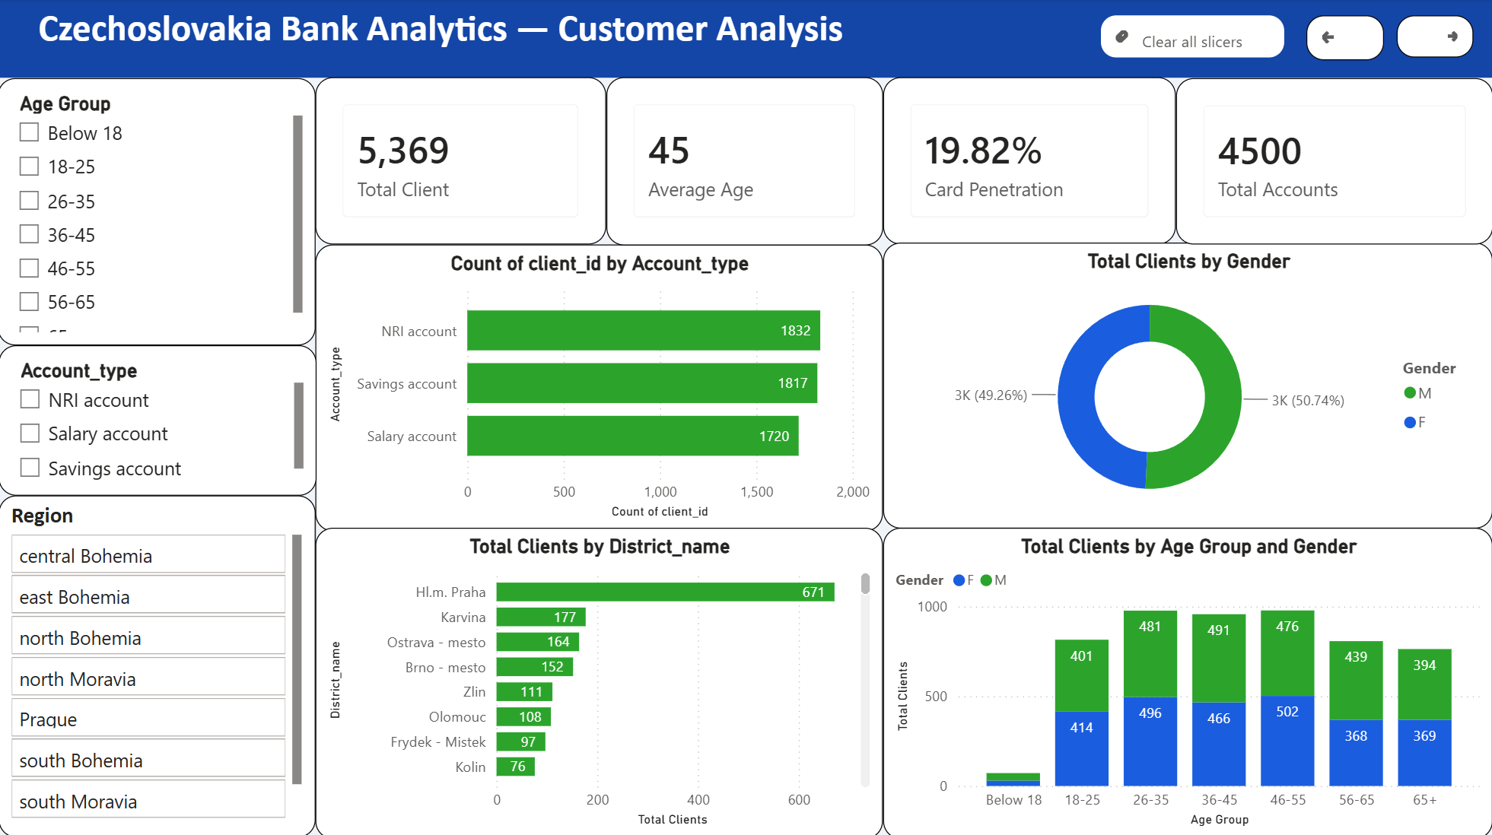
Customer Dashboard (1/2)

Slide 44
Customer Dashboard Insights (2/2)
Key Insights
The bank serves 5,369 customers with an average age of 45 years, indicating a mature and stable customer base.
Customer distribution is well balanced between male (50.74%) and female (49.26%), reducing reliance on a single demographic.
Customers are concentrated in the 26–55 age group, highlighting strong penetration among economically active individuals.
Prague has the highest customer concentration, making it the bank's strongest market.
Account ownership is evenly split across Savings, Salary, and NRI accounts, indicating a diversified customer portfolio.
Recommendation
Expand into lower-penetration districts, attract younger customers, and increase cross-selling to existing account holders.

Slide 45
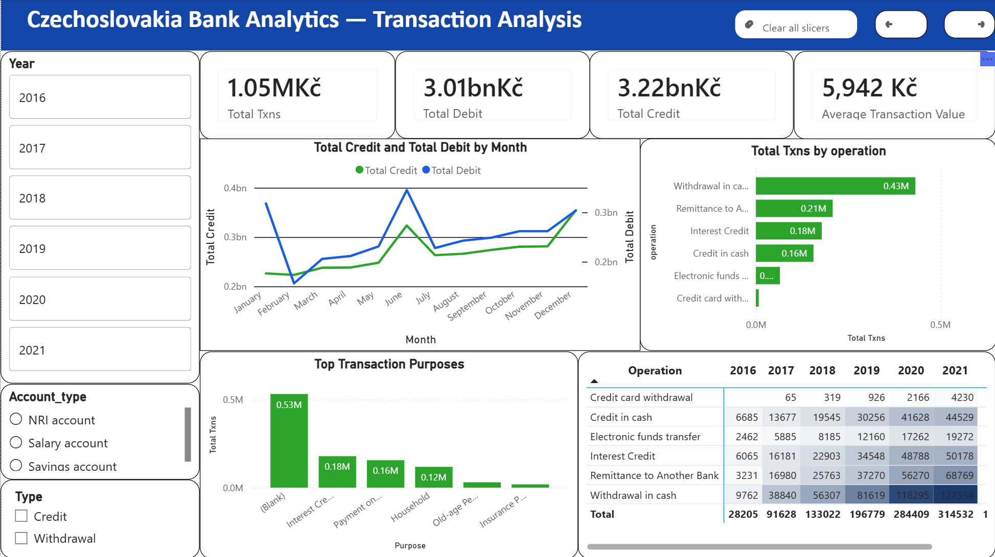
Transaction Dashboard (1/2)

Slide 46
Transaction Dashboard Insights (2/2)
Key Insights
Customers completed 1.05 million transactions with an average transaction value of 5,942 Kč, demonstrating strong customer engagement.
Total Credit (3.22 bn Kč) is slightly higher than Total Debit (3.01 bn Kč), supporting a healthy liquidity position.
Cash withdrawals are the most common transaction type, indicating continued dependence on cash.
Transaction volumes have grown steadily from 2016 to 2021, reflecting increasing customer activity.
A large share of transaction purposes is recorded as Blank, suggesting an opportunity to improve transaction data quality.
Recommendation
Encourage digital payments, improve transaction purpose capture, and continue promoting electronic banking.

Slide 47
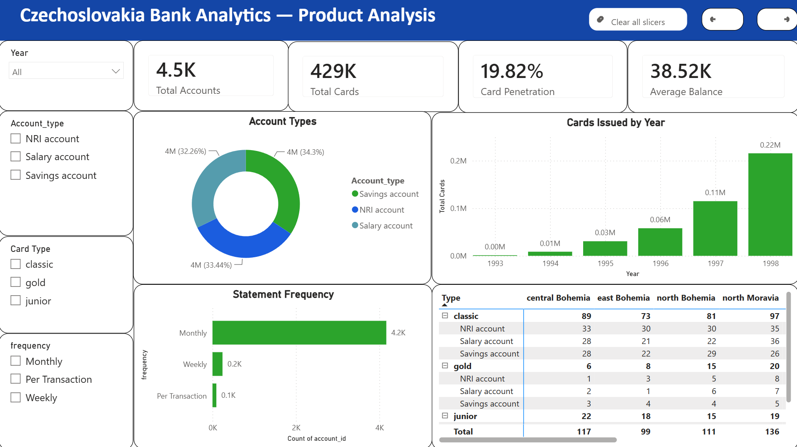
Product Analysis (1/2)

Slide 48
Product Analysis (2/2)
Key Insights
The bank manages 4,500 accounts and 429 cards, but card penetration is only 19.82%, leaving significant growth potential.
Savings, Salary, and NRI accounts contribute almost equally, indicating a balanced product portfolio.
Classic cards dominate the portfolio, while premium products remain underutilized.
Monthly statements are preferred by most customers, showing a clear customer communication preference.
Card issuance increased significantly over the years, reflecting growing product adoption.
Recommendation
Increase card penetration through bundled offers and promote premium card products to eligible customers.

Slide 49
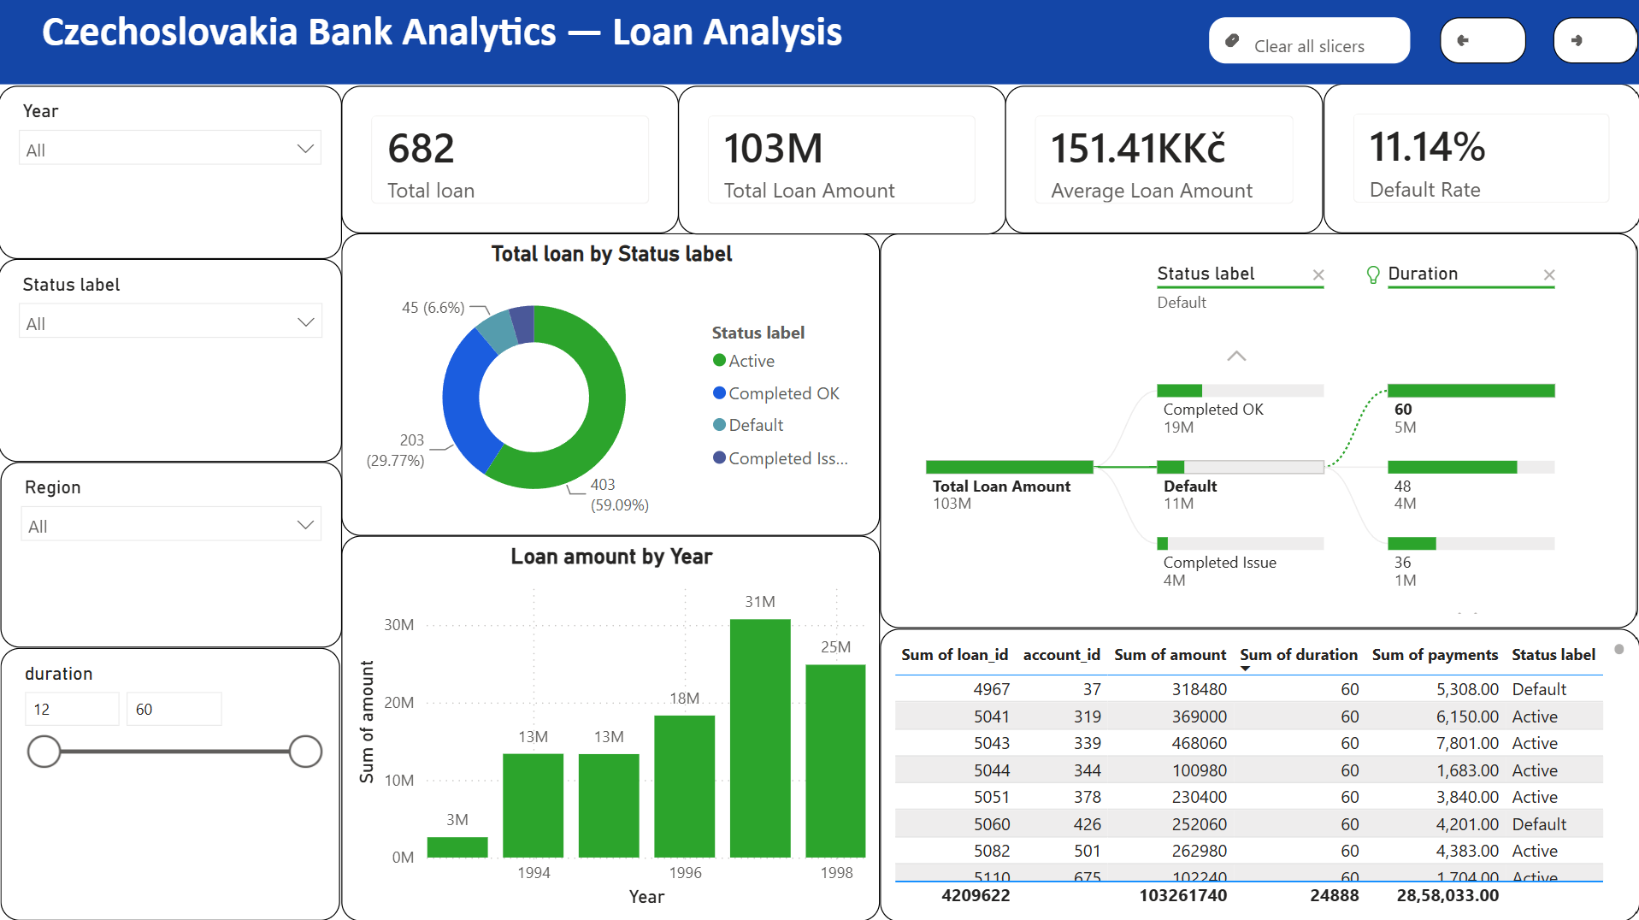
Loan Analysis (1/2)

Slide 50
Loan Analysis (2/2)
Key Insights
The bank has issued 682 loans totaling 103 million Kč, with an average loan size of 151.41K Kč.
The default rate is 11.14%, meaning nearly 89% of loans are performing, indicating a healthy loan portfolio.
Most loans are either Active or Completed Successfully, demonstrating effective credit management.
Loan disbursements increased over time before peaking, showing strong historical lending growth.
Defaults represent a relatively small share of the overall portfolio.
Recommendation
Strengthen early risk monitoring while expanding lending to low-risk customer segments.

Slide 51
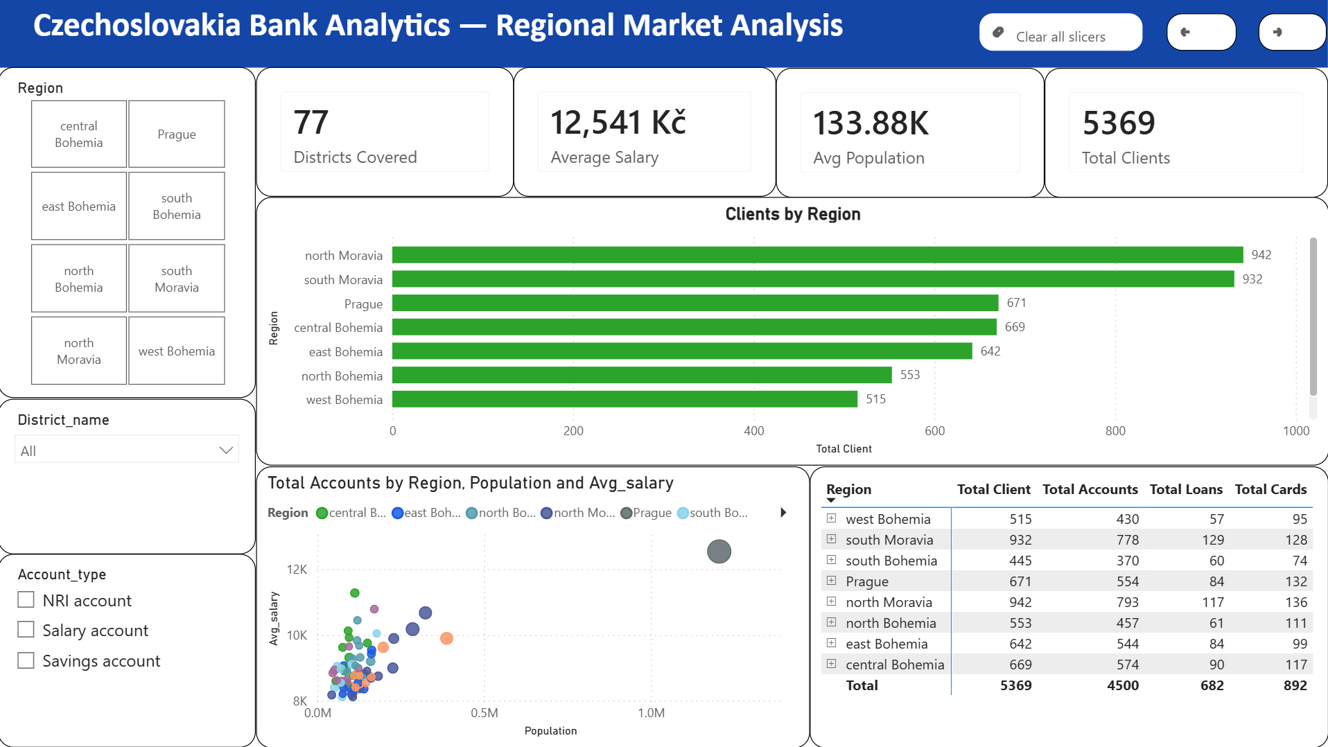
Regional Market Analysis (1/2)

Slide 52
Regional Market Analysis (2/2)
Key Insights
The bank serves customers across 77 districts, providing broad regional coverage.
North Moravia and South Moravia have the highest customer base, making them the bank's strongest regional markets.
South Bohemia has the lowest customer base, indicating an opportunity for expansion.
Average regional salary is 12,541 Kč, supporting stable banking demand.
Customer, account, and loan distribution are closely aligned across regions, reflecting balanced market penetration.
Recommendation: Focus acquisition campaigns in underperforming regions while strengthening services in high-growth markets.

Slide 53
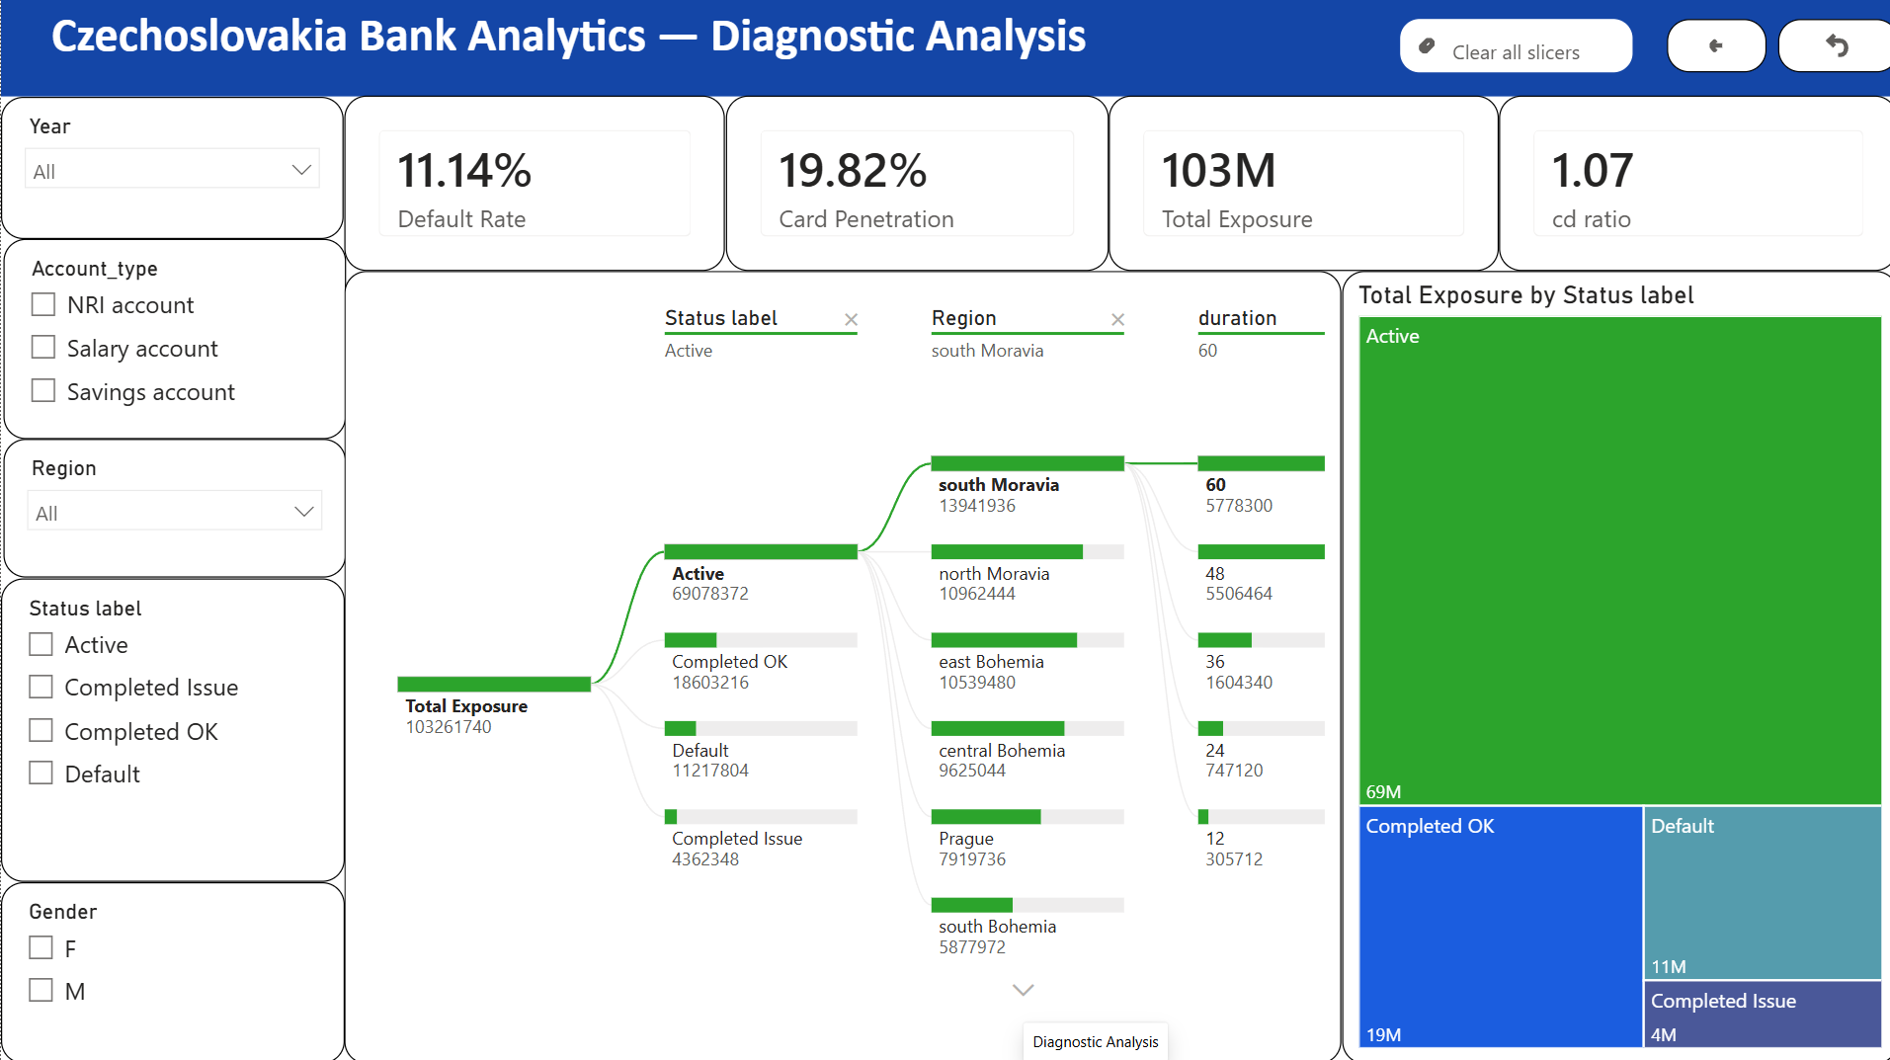
Diagnostic Analysis (1/2)

Slide 54
Diagnostic Analysis (2/2)
Key Insights
Total loan exposure is 103 million Kč, with Active loans accounting for 69 million Kč, indicating a productive lending portfolio.
The 11.14% default rate remains manageable relative to the total loan book.
South Moravia contributes the highest loan exposure, making it a strategically important region.
The Credit-to-Deposit ratio of 1.07 indicates efficient utilization of deposits for lending while requiring ongoing liquidity monitoring.
Most exposure is concentrated in performing loans, demonstrating sound portfolio quality.
Recommendation
Maintain strong credit risk controls, increase deposit mobilization, and closely monitor high-exposure regions.

Slide 55
Overall Business Insights
Key Findings
Customer base is mature, with an average age of 45 years.
Customer distribution across account types is balanced.
Prague contributes the highest number of customers.
The loan portfolio is healthy, with a 11.14% default rate.
Banking operations are transaction-intensive, with 1.049M transactions.
Debit transactions exceed credits, reflecting active customer spending.
Regional analysis highlights opportunities for expansion in lower-penetration districts.
Predictive analytics can improve future lending decisions.

Slide 56
Recommendations
Expand Customer Acquisition
Target younger customers through digital-first banking products and student accounts.
Increase presence in low-penetration districts using localized marketing campaigns.
Credit Strategy
Use Logistic Regression to screen high-risk loan applicants.
Continuously monitor long-duration loans.
Regional Strategy
Expand into under-served districts.
Use district-level insights for marketing.
Operational Strategy
Promote digital transactions.
Enhance dashboard automation for real-time decision-making.

Slide 57
Final Recommendations (1/3)
The core business — lending, liquidity, and engagement — is healthy. The growth opportunity is product cross-sell and regional expansion, backed by predictive risk models to scale safely.
Cross-Sell & Product Growth: Card penetration is only 19.82% of accounts — the largest untapped revenue opportunity.
Regional Expansion: Redirect acquisition spend to underpenetrated districts (e.g. South Bohemia) over saturated markets.
Risk Management: Loan default is 11.14% on 103M Kč exposure — use the Logistic Regression model as a pre-approval screen.
Digital Engagement: Cash withdrawals still dominate — promote digital payments and fix blank transaction-purpose data.

Slide 58
Final Recommendations (2/3)
Business Area | Key Metric | Recommendation
Customer & Demographics | Avg age 45; 26–55 segment dominant; Prague top district | Grow Prague/urban premium products; launch youth & student banking
Transactions | 1.05M txns; Credit 3.22bn Kč vs Debit 3.01bn Kč; cash dominant | Promote digital payments; fix blank transaction-purpose data
Loans & Risk | 682 loans; 103M Kč exposure; 11.14% default rate | Deploy Logistic Regression model as a pre-approval risk screen
Cards & Products | 4,500 accounts; 429 cards → 19.82% penetration | Bundle card offers; upgrade loyal Classic holders to Gold
Regional Markets | 77 districts; Moravia strongest; South Bohemia weakest | Reallocate acquisition spend to underpenetrated districts

Slide 59
Final Recommendations (3/3)
Priority Action Roadmap
Short Term (0–3 months):
Launch card bundling offers to lift the 19.82% card penetration rate
Fix blank transaction-purpose data capture at the point of entry
Medium Term (3–9 months):
Deploy the Logistic Regression model as a pre-approval risk screen for loans
Run targeted acquisition campaigns in underpenetrated districts (e.g. South Bohemia)
Long Term (9+ months):
Expand youth/student banking products to build the under-18 pipeline
Scale digital payment adoption to reduce cash-withdrawal dependency

Slide 60
Thank you

